Slide 1
Interrupt on Zynq
By Dr. Min He
Real-time computing often requires interrupts to respond quickly to events.
It’s not hard to design an interrupt-driven system once you grasp how the interrupt structure of the Zynq SoC works.

Slide 2
Outline
Interrupts and Types of Interrupts
The Zynq Soc’s Interrupt Structure
GIC Interrupt Sources
Processing The Interrupts on ZYNQ
Implement The interrupt Structure
Using Interrupt in Standalone BSP

Slide 3
Interrupts and Types of Interrupts
In embedded processing, an interrupt is a signal that temporarily halts the processor’s current activities.
An interrupt can come from one of the three following places:
Hardware – An electronic signal connected directly to the processor
Software – A software instruction loaded by the processor
Exception – An exception generated by the processor when an error or exceptional event occurs

Slide 4
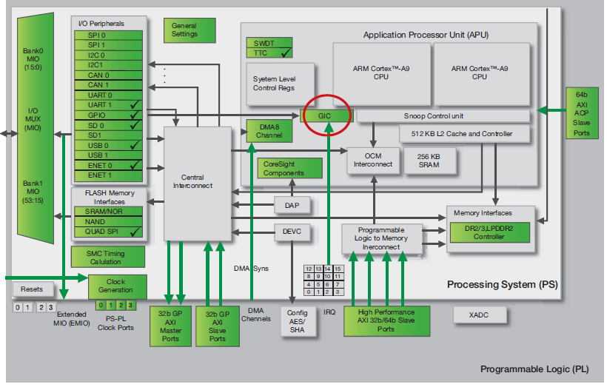
The Zynq Soc’s Interrupt Structure
As processors get more advanced, there are a number of sources interrupts can come from.
The Zynq SoC uses a Generic Interrupt Controller (GIC), shown above, to process interrupts.
Notes:
As processors get more advanced, there are a number of sources interrupts can come from.
The Zynq SoC uses a Generic Interrupt Controller (GIC), as shown in Figure 1, to process interrupts.

Slide 5
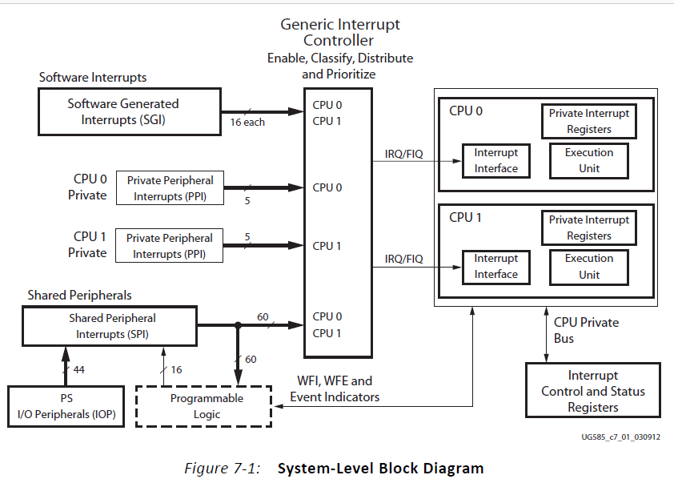

Slide 6
GIC Interrupt Sources
The GIC handles interrupts from the following sources:
Software-generated interrupts – There are 16 such interrupts for each processor. They can interrupt one or both of the Zynq SoC’s ARM® Cortex™-A9 processor cores.
Shared peripheral interrupts – Numbering 60 in total, these interrupts can come from the I/O peripherals, or to and from the programmable logic (PL) side of the device. They are shared between the Zynq SoC’s two CPUs.
Private peripheral interrupts – The five interrupts in this category are private to each CPU—for example CPU timer, CPU watchdog timer and dedicated PL-to-CPU interrupt.
Notes:
The GIC handles interrupts from the following sources:
• Software-generated interrupts – There are 16 such interrupts for each processor. They can interrupt one or both of the Zynq SoC’s ARM® Cortex™-A9 processor cores.
• Shared peripheral interrupts – Numbering 60 in total, these interrupts can come from the I/O peripherals, or to and from the programmable logic (PL) side of the device. They are shared between the Zynq SoC’s two CPUs.
• Private peripheral interrupts – The five interrupts in this category are private to each CPU—for example CPU timer, CPU watchdog timer and dedicated
PL-to-CPU interrupt.

Slide 7
Processing The Interrupts on The ZYNQ
The interrupt is shown as pending.
The processor stops executing the current thread.
The processor saves the state of the thread in the stack to allow processing to continue once it has handled the interrupt.
The processor executes the interrupt service routine, which defines how the interrupt is to be handled.
The processor resumes operation of the interrupted thread after restoring it from the stack.

Slide 8
Implement The interrupt Structure
Two functions:
An interrupt setup function to configure the interrupt.
The interrupt setup is a reusable routine that allows for constructing different interrupts.
Generic for all interrupts within a system.
An interrupt service routine to define the actions that will take place when the interrupt occurs

Slide 9
Using Interrupt in Standalone BSP
The BSP contains a number of functions that greatly ease the task of creating an interrupt-driven system. They are provided within the following header files:
xparameters.h – This file contains the processor’s address space and the device IDs. The interrupt ID is provided from xparameters_ps.h which is included in xparameters.h.
xscugic.h – This file holds the drivers for the configuration and use of the GIC.
xil_exception.h – This file contains exception functions for the Cortex-A9.

Slide 10
Define our own ID using Macro
#define GPIO_DEVICE_ID XPAR_XGPIOPS_0_DEVICE_ID
#define INTC_DEVICE_ID XPAR_SCUGIC_SINGLE_DEVICE_ID
#define GPIO_INTERRUPT_ID XPS_GPIO_INT_ID

Slide 11
Interrupt Setup
Steps to setup interrupt:
Initialize the Zynq SoC’s exceptions;
Configure and initialize the GIC;
Connect the GIC to the interrupt-handling hardware.
Header files needed:
xil_exception.h: This file contains exception functions for the Cortex-A9.
xscugic.h: This file holds the drivers for the configuration and use of the GIC.

Slide 12
Interrupt Setup Example
// Initialize the GIC
XScuGic_Config *IntcConfig;
IntcConfig = XScuGic_LookupConfig(INTC_DEVICE_ID);
XScuGic_CfgInitialize(GicInstancePtr, IntcConfig, IntcConfig->CpuBaseAddress);
// Connect to MCU exception handler
Xil_ExceptionRegisterHandler(XIL_EXCEPTION_ID_INT, (Xil_ExceptionHandler)XScuGic_InterruptHandler, GicInstancePtr);
Xil_ExceptionEnable();
// Connect GPIO interrupt to handler
XScuGic_Connect(&INTCInst, INTC_GPIO_INTERRUPT_ID, (Xil_ExceptionHandler)BTN_Intr_Handler, (void *)GpioInstancePtr);
// Enable peripheral interrupt
XGpio_InterruptEnable(&BTNInst, BTN_INT);
XGpio_InterruptGlobalEnable(&BTNInst);
// Enable GPIO interrupts in the controller
XScuGic_Enable(&INTCInst, INTC_GPIO_INTERRUPT_ID);

